Slide 1
Əłxʷl’lstim Cause it to come back to life Nsyilxcn adult fluency program
Sʔímlaʔxʷ Michele Johnson PhD
Sk̓awílx Sarah Alexis
Syilx Language House, Penticton BC Canada
SILS Conference, Lethbridge Alberta June 7-9, 2018

Slide 2
Context
kʷu swit – who we are
kʷu k̓aʔkín – where we are
Syilx, Interior Salish
x̌̌əl stim – why we do this
Notes:
Introductions, describe Interior Salish and Syilx territory, our population, describe our level of endangerment.
describe our mission to train speakers and record Elders.
Show film.

Slide 3
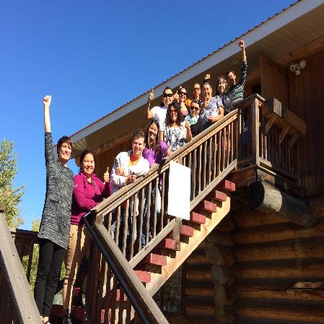
Syilx Language House
The Syilx Language House was formed in 2015 to deliver 1,600 hours of curriculum in immersion to adults from across the Syilx Nation in BC, and record and publish our remaining fluent Elders
We are located in Penticton, BC on the Penticton Indian Band Reserve

Slide 4
Syilx Language House
1,600 hour adult program
Full 1,600 hour curriculum
Nsyilxcn curriculum (interiorsalish.com)
12 adults
2 days a week for 4 years (11 hrs/wk)
Daily quizzes
Annual filmed speaking assessments
Annual community feedback
Notes:
We are currently 11 learners: 3 supported by Westbank First Nation; 2 Osoyoos Indian Band; 1 Sensisyusten House of Learning ; 1 School District 23; 1 Outma Sqilxw School; 3 full time staff; and 1 volunteer.

Slide 5
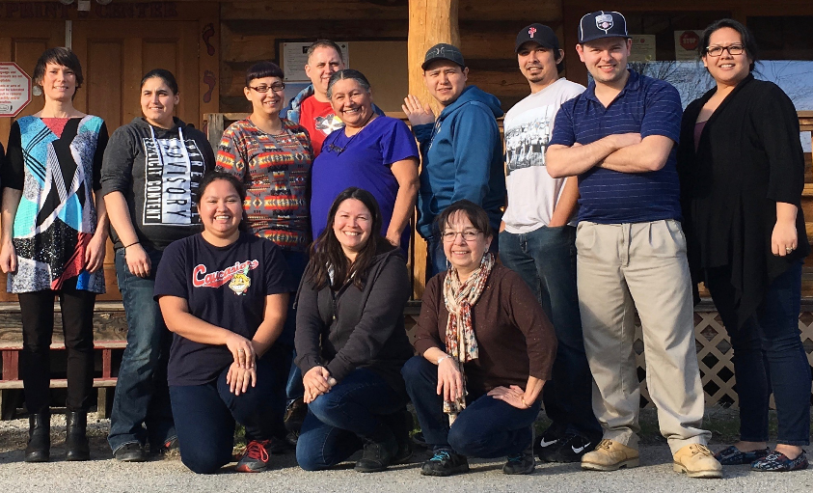
First cohort of learners

Slide 6
Acquisition methods
Full immersion
Direct acquisition methods
TPR, TPR-S, partner exercises
Sequenced curriculum
Story-based teaching
Quizzes, filmed assessments
Learning by teaching
Transcribing and recording Elders

Slide 7
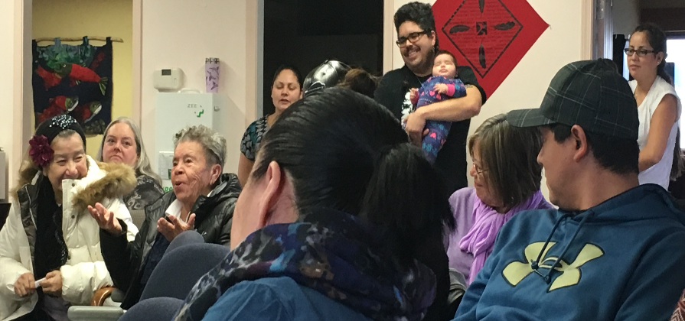
Community feedback

Slide 8
Community feedback
C’ris, Student: “The work is incredibly hard, and fulfilling, and emotional at times, and is part of the healing process.”
C’ucuasq’t, Elder: “These are the greatest language results I have ever witnessed.”
Kiʔláwna Chief Clarence Louie, OIB: “Everything costs money. Bands need to put their money where their mouths are and make sure that this is a priority.”

Slide 9
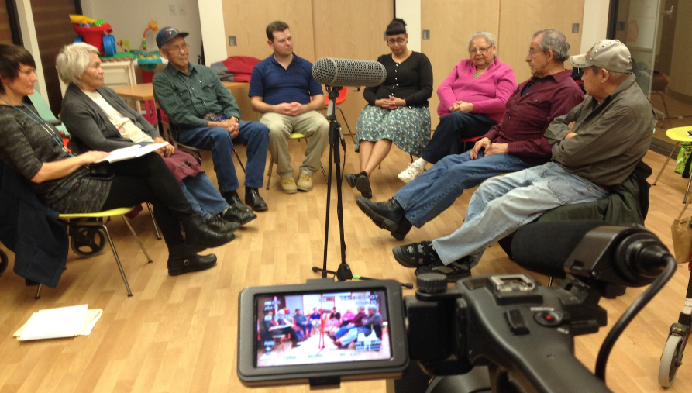
Elder recording

Slide 10
Recordings in the classroom
12 Elders collaborate
Freely shared recordings create advanced literature
Students listen & discuss advanced cultural knowledge
Question and Answer (known as TPRS method)
www.thelanguagehouse.ca

Slide 11
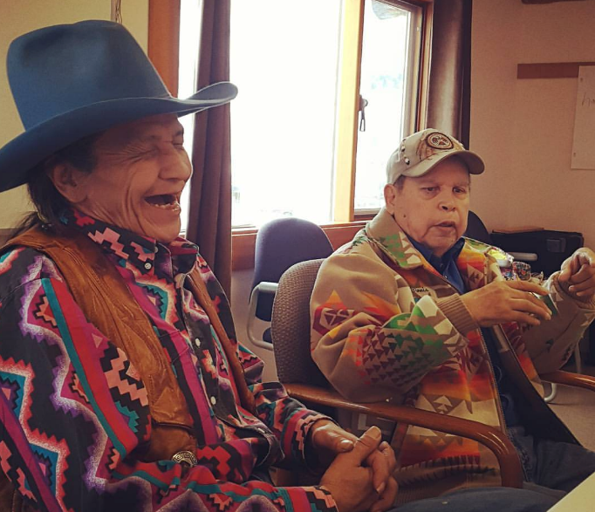

Slide 12
Results-based
Assessed at Mid-intermediate speech after 1,000 hours
High student retention
Strong partnerships with bands, employers, funders, several communities
Academic partnerships
We are healing our communities by raising the bar to acknowledge fluency is possible, by role modeling, capacity building and mentorship

Slide 13
Filmed assesments
Filmed speaking assessments follow the Maori model of cartoon panels
Compared to international benchmarks
Beginner, Intermediate, Advanced
We achieved mid-intermediate after 1,000 hours
Speaking, Listening, Reading, & Writing

Slide 14
Our Next Steps: 2020 Plan
Create 3 language houses, Westbank, Penticton, Osoyoos BC
New 4 year, 1,600 hour program starts September, 2019
60-90 young adult students, supported by Bands & workplaces
6 intermediate teachers (graduates of first cohort)
10 Recording trainees recording Elders
Coordination, training, teaching by Syilx Language House with Salish School of Spokane Curriculum
Notes:
All students are supported by workplaces and each band will fundraise.
Workplace policies are necessary to send staff and turn off English by 2024.

Slide 15
Contact Us
Sʔímlaʔxʷ Michele K Johnson michelekjohnson@gmail.com
Sk̓awílx Sarah Alexis syilxlanguage@gmail.com
You can find our materials at our website www.thelanguagehouse.ca
Follow us on Facebook (@syilxlanguage), twitter (@michelekjohnson), and Instagram (@s7imla7xw)

Slide 16
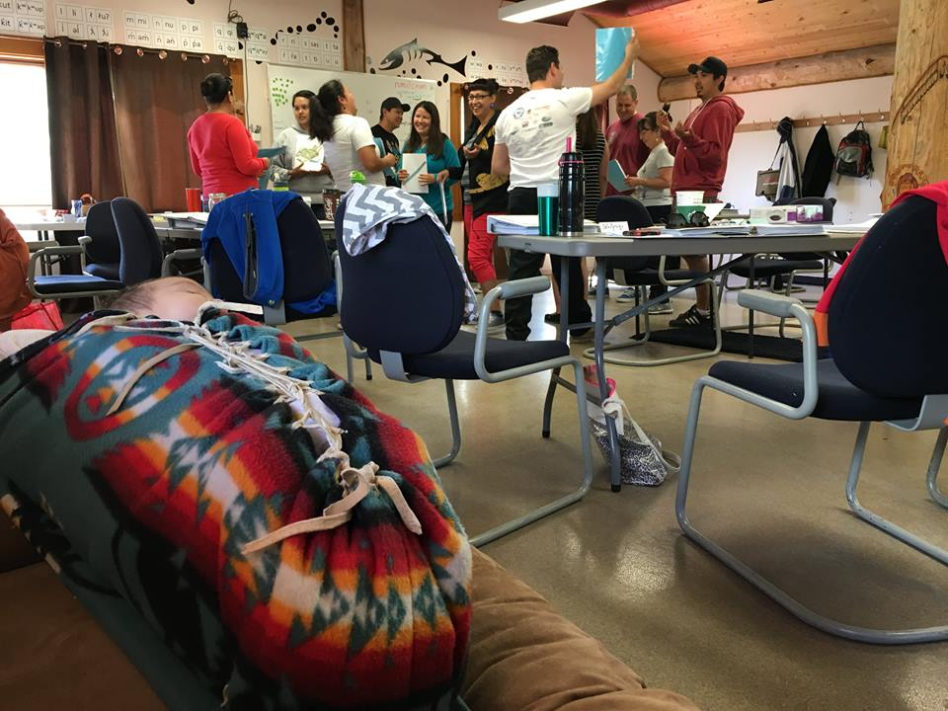
limləmt

